Slide 1
What Drives Starbucks Drink Calories?
Notes:
Introduce purpose: determine key calorie and sugar drivers.

Slide 2
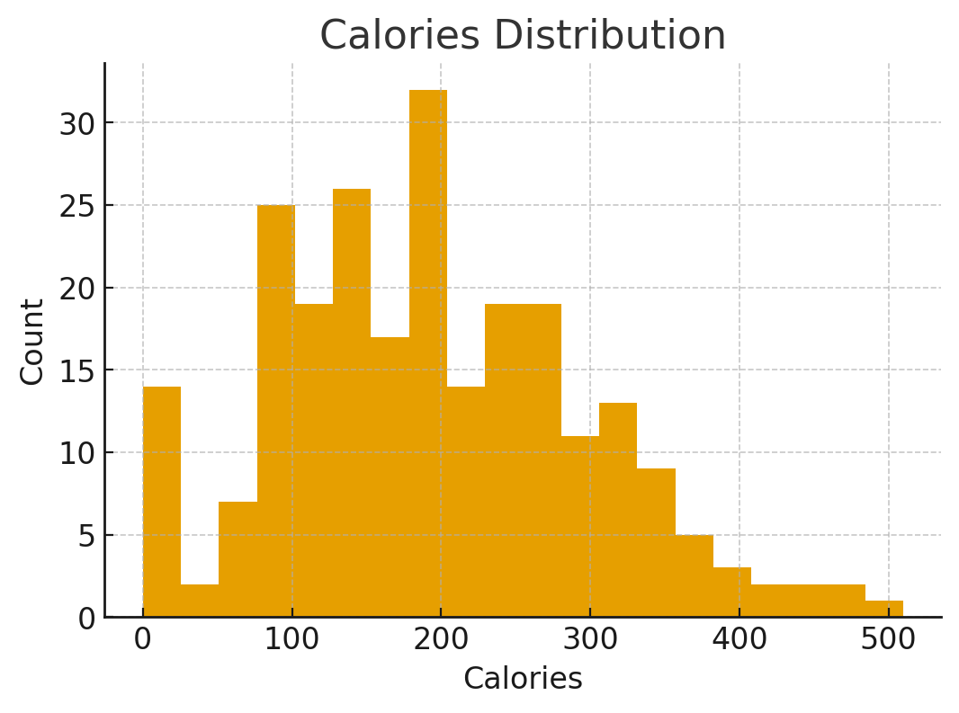
Question: How Are Calories Distributed?
Notes:
Show calorie variability and note clustering between low-cal and high-cal beverages.

Slide 3
Finding: Two Distinct Calorie Populations
Notes:
Low-cal coffees vs high-cal blended and flavored drinks.

Slide 4
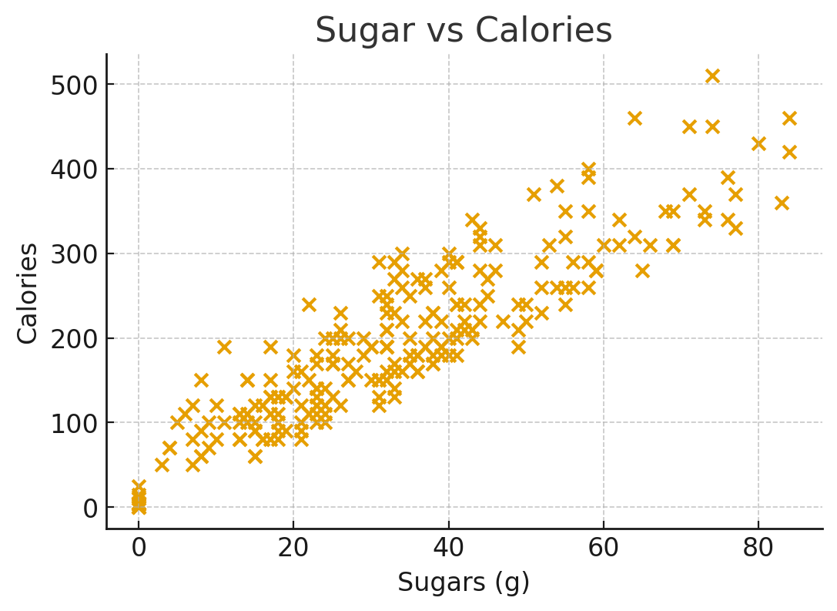
Question: What Drives Calorie Spikes?
Notes:
Illustrate sugar-to-calorie linear relationship; sugar is primary driver.

Slide 5
Finding: Sugar Predicts Calories
Notes:
Executives should note sugar control = calorie control.

Slide 6
Strategic Opportunities
Notes:
Focus reformulation on the top calorie producers; create reduced-sugar SKUs.

Slide 7
Final Recommendation
Notes:
Concentrate changes on top 20% high-calorie drinks for large menu impact.

